Slide 1

Exam AZ-500: Microsoft Azure Security Technologies Crash Course
Tim Warner

Slide 2

Tim Warner
Based in Nashville, TN, US
Central time zone
26-year MCT, 6-year MVP
Badge: TechTrainerTim.com

Slide 3
Course Materials
timw.info/az500

Slide 4
Learning Goals
Introduction
Manage identity and access (25–30%)
Secure networking (20–25%)
Secure compute, storage, and databases (20–25%)
Manage security operations (25–30%)
AZ-500 preparation tips

Slide 5
Setting Expectations
Let's avoid slide show fatigue
We'll learn by doing – at least 80 percent demo
Case study/scenario approach
I’m here to answer your questions – take advantage of this!
Use the Q&A panel

Slide 6
Break Schedule (Central time zone)
07:00am - Start
08:00am - 8-min break
09:00am - 8-min break
10:00am - 8-min break
11:00AM - 8-min break
11:55pm - Finish

Slide 7

Session Recordings

Slide 8

Session Recordings

Slide 9

Session Recordings

Slide 10


Mobile Browser: learning.oreilly.com

Slide 11



O'Reilly Mobile App

Slide 12
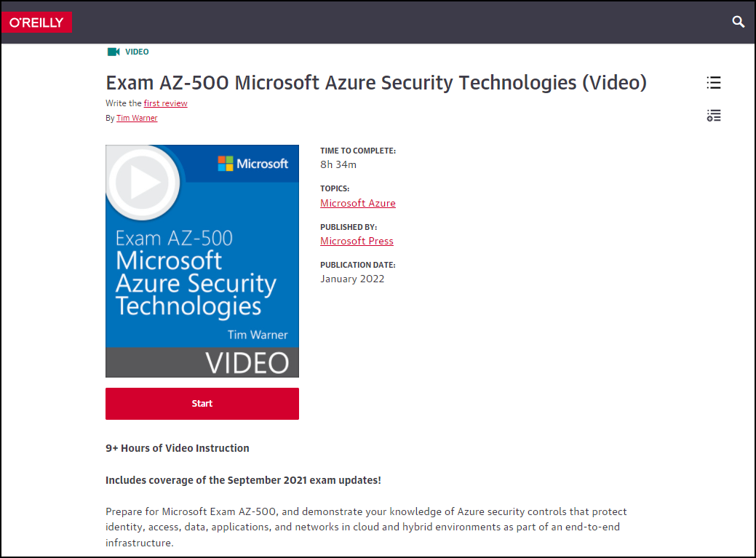
AZ-500 Video Course (MS Press)
timw.info/msp500

Slide 13
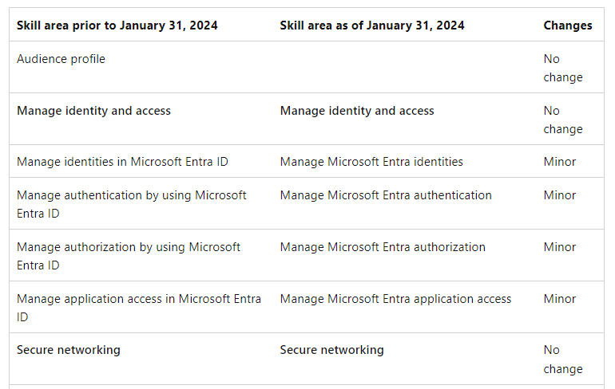
Exam AZ-500 Content Changes

Slide 14
Certification Renewal
Associate and Expert certs are valid for one year
Credential will always be on your MS transcript
At six-month mark you’ll be asked to renew
Free online assessment at Microsoft Learn
Renewal extends your certification for 365 from original achievement date

Slide 15
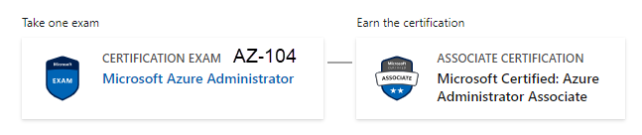
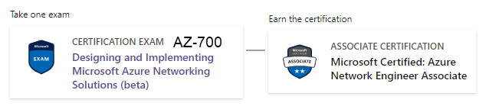

Related Certifications

Slide 16
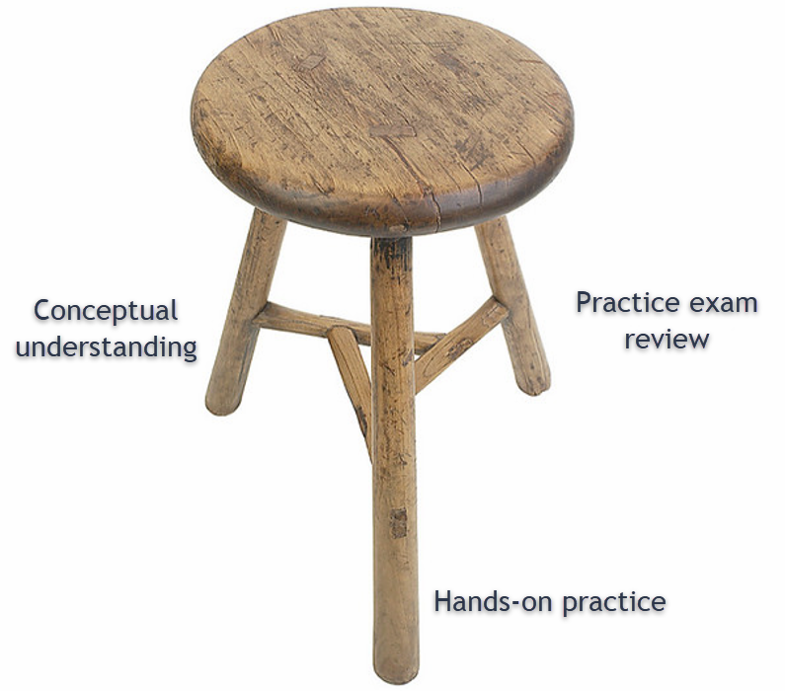
Tim's Certification Study Model

Slide 17
Thank you!
Course materials: timw.info/az500
Twitter: @TechTrainerTim
Work: timw.info/ps
Web: TechTrainerTim.com

Slide 18
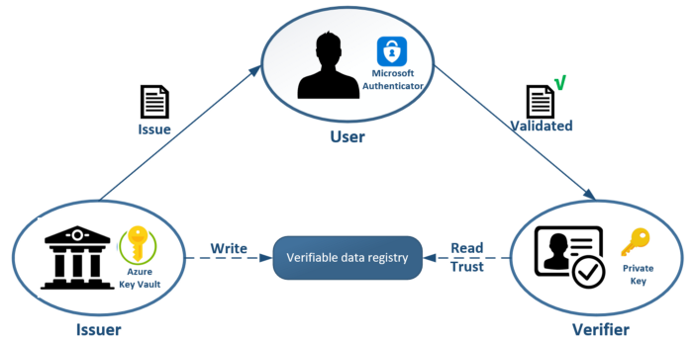
Entra Verified ID

Slide 19
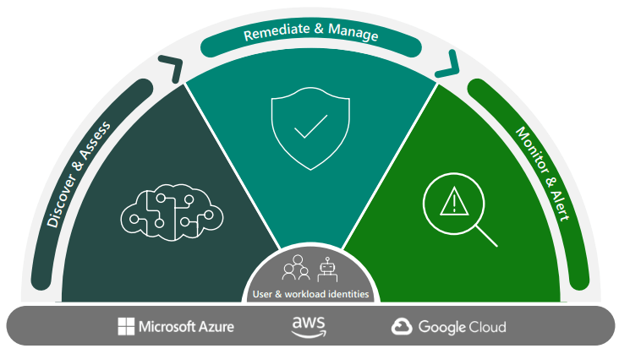
Entra Permissions Management

Slide 20
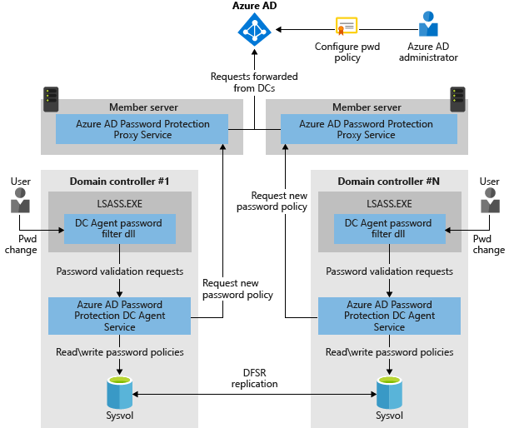
Azure AD Password Protection

Slide 21
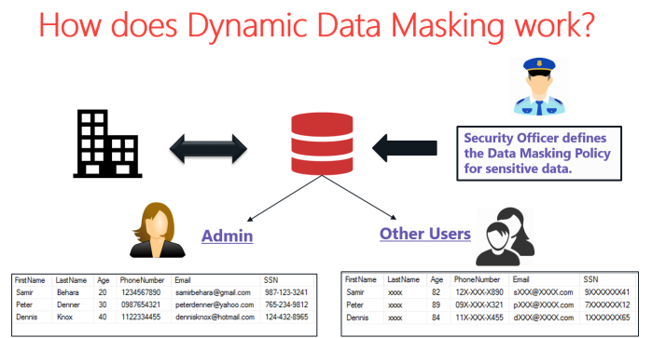
Dynamic Data Masking (DDM)

Slide 22
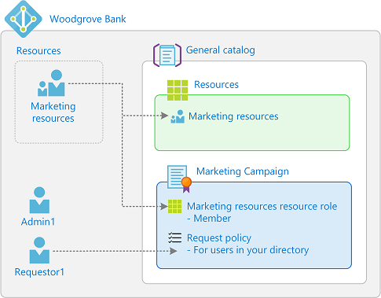
Entitlement Management

Slide 24
Manage Identity and Access

Slide 25
AAA Model
Authentication
Identity verification
Authorization
Access scope
Accounting
Successful and failed AuthN and AuthZ attempts

Slide 26
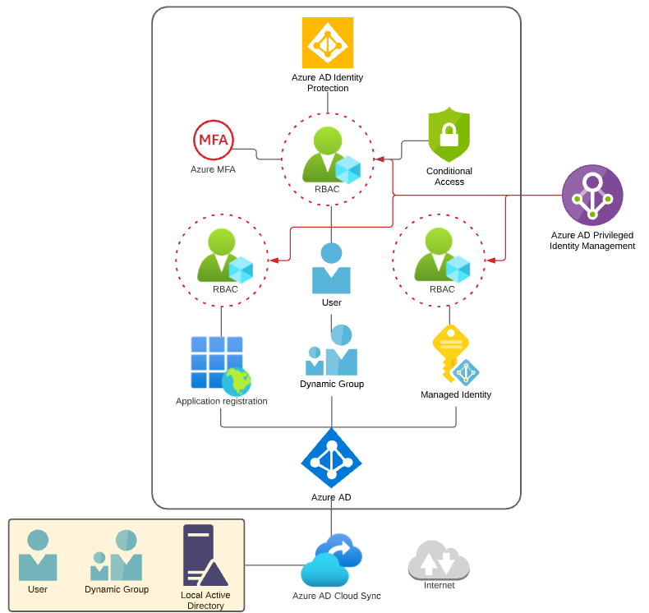
Identity and Access Scenario

Slide 27

Tenant vs. Subscription

Slide 28

Hybrid Identity

Slide 29

Azure Management Scopes
/ Tenant Root

Slide 30
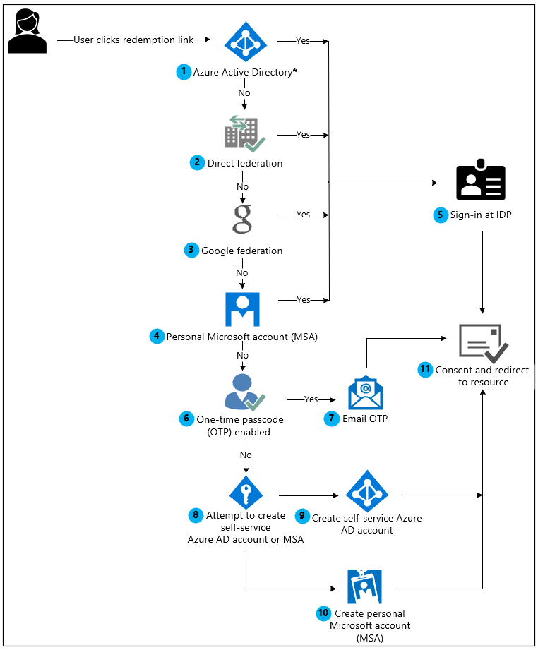
Azure AD B2B Collaboration

Slide 31
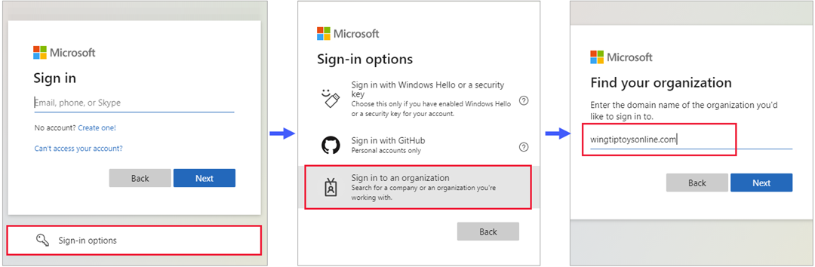
Azure AD B2B Collaboration

Slide 32
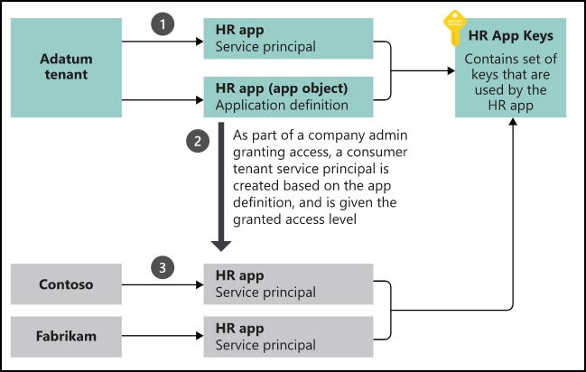
App Registrations & Service Principals

Slide 33


Azure AD B2C

Slide 34

Azure AD Domain Services

Slide 35
Azure AD Connect

Slide 36

Passthrough Authentication

Slide 37

ADFS Federation

Slide 38
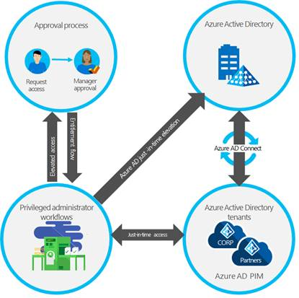
Azure AD PIM

Slide 39
Implement Platform Protection

Slide 40
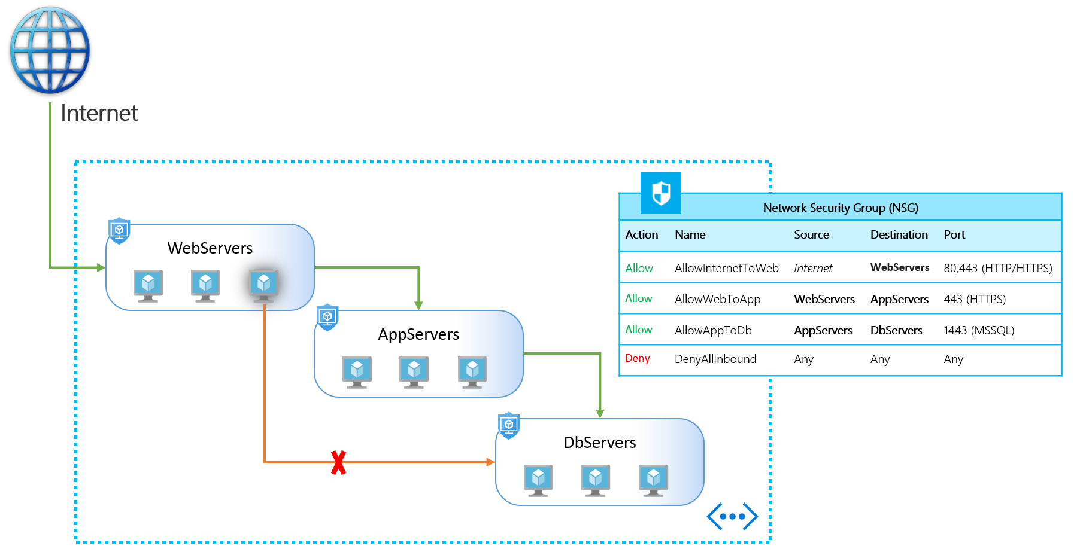
NSGs and ASGs

Slide 41

Multi-Region High Availability

Slide 42

Multi-Region High Availability

Slide 43
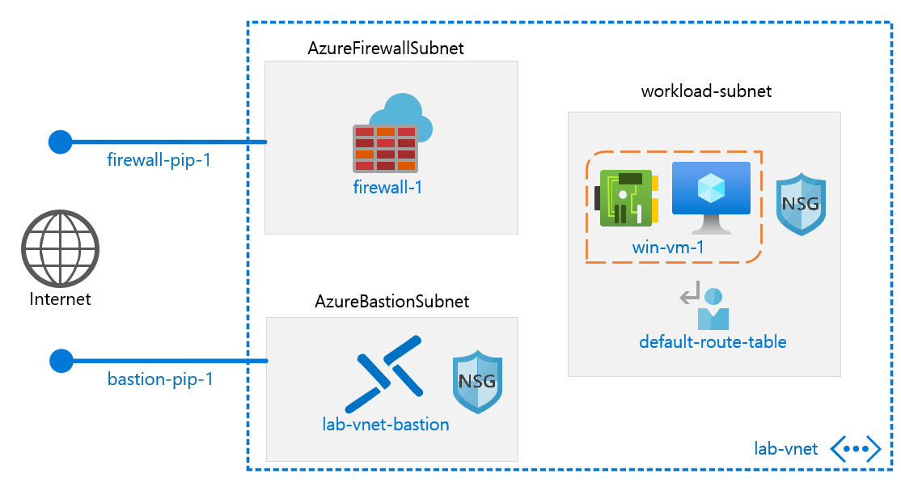
Azure Firewall

Slide 44
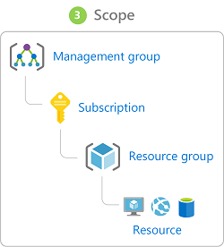
Management Scopes
/ Tenant Root

Slide 45

Service endpoints

Slide 46
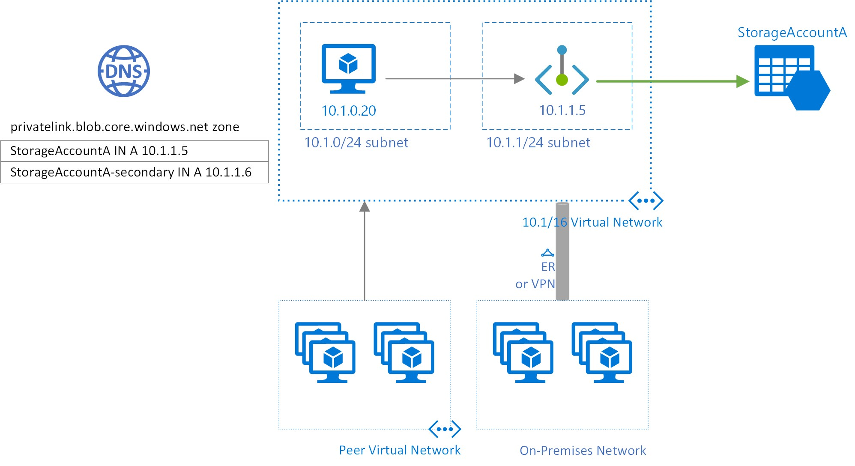
Private endpoints

Slide 47
Compute and Networking

Slide 48
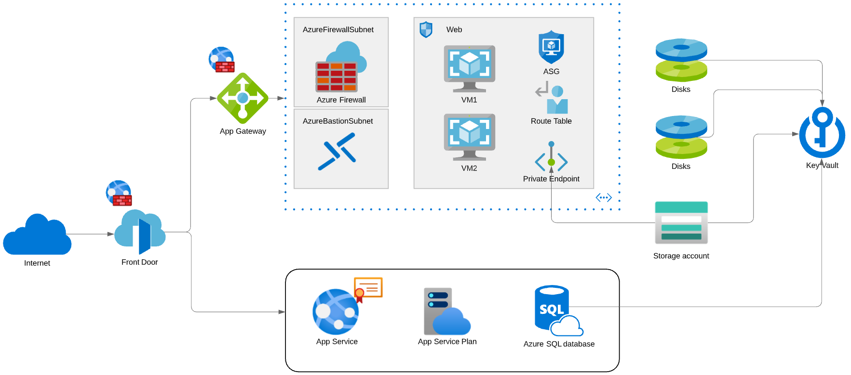
Compute and Networking Scenario

Slide 49
Manage Security Operations

Slide 50
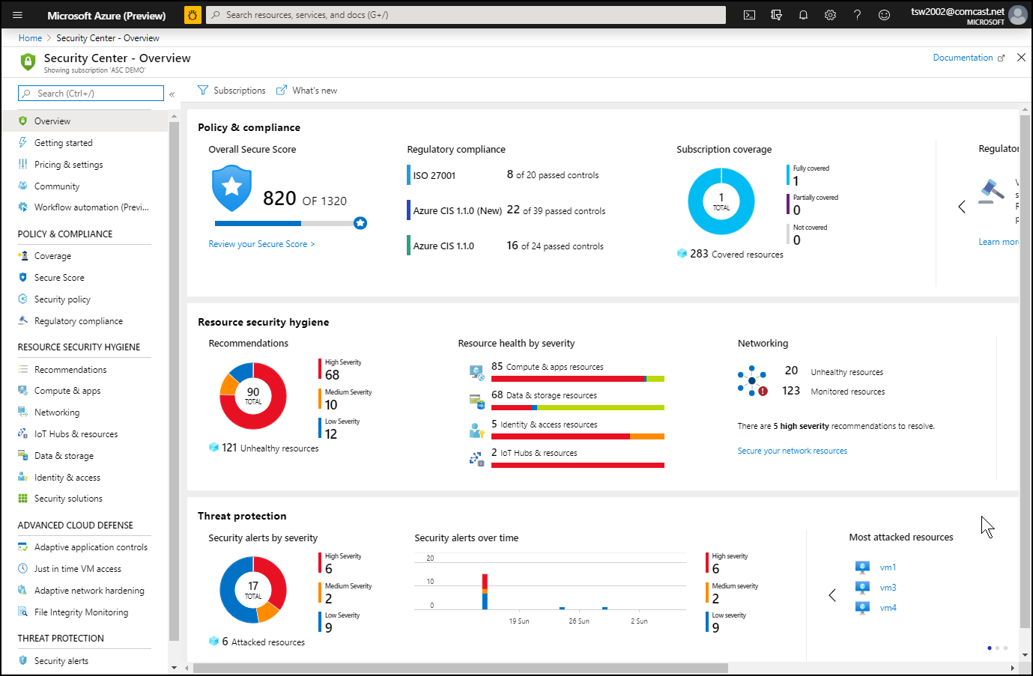
Azure Security Center

Slide 51
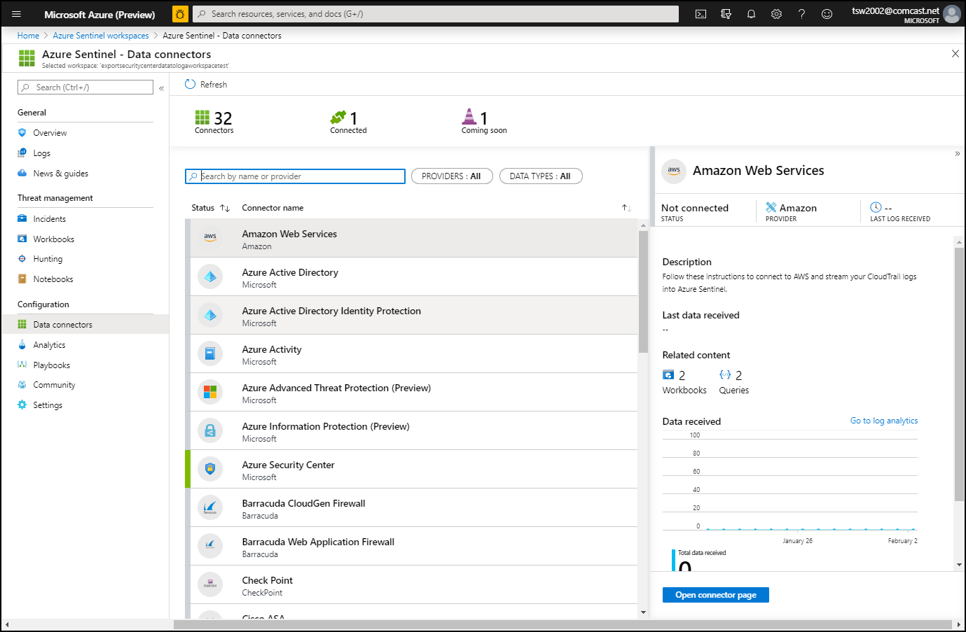
Azure Sentinel

Slide 52
Secure Data and Applications

Slide 53
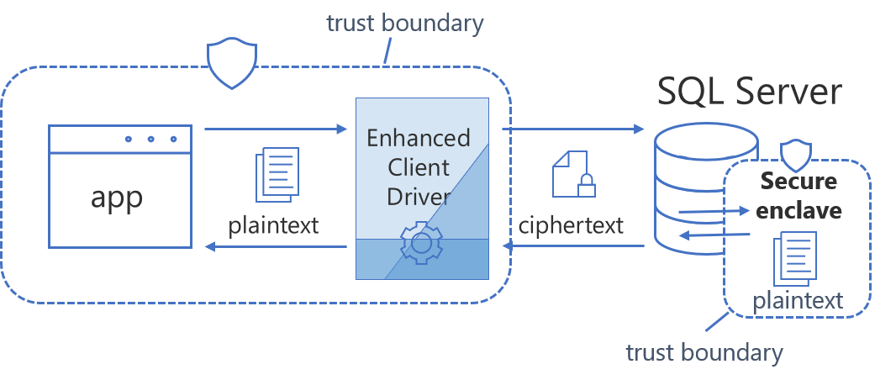
Always Encrypted

Slide 54
Security Operations

Slide 55
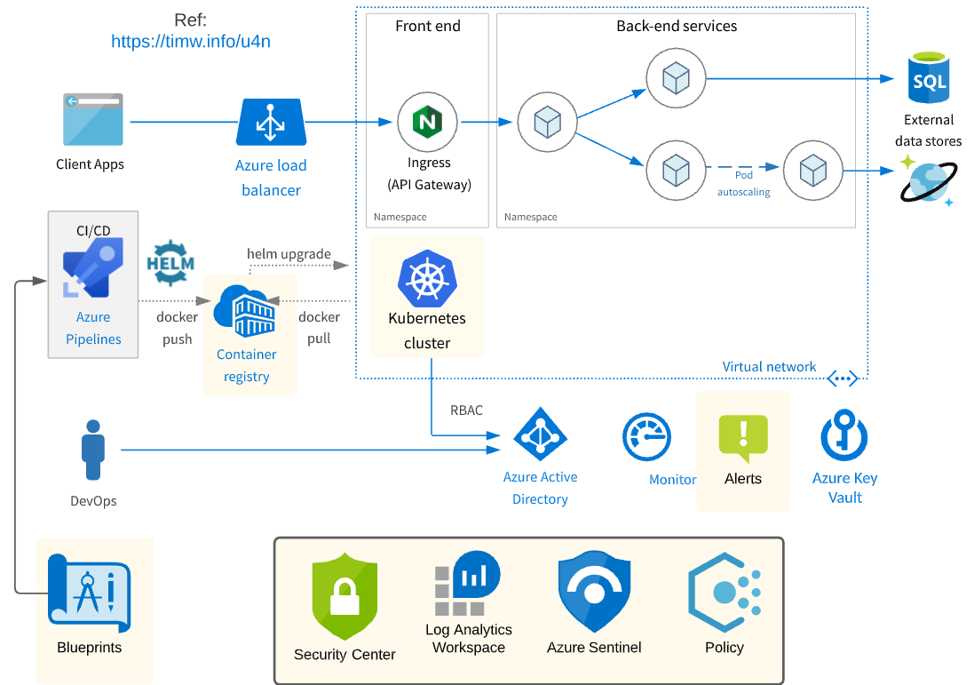
Security Operations Scenario

Slide 56
Exam AZ-500 Item Types

Slide 57

Single Answer Multiple Choice

Slide 58

Multiple Answer Multiple Choice

Slide 59
Repeated Scenario
You need to move an Azure VM to another hardware host.
Solution: You redeploy the VM.
Does this solution meet the goal?
Yes
No

Slide 60
Repeated Scenario
You need to move an Azure VM to another hardware host.
Solution: You enable boot diagnostics.
Does this solution meet the goal?
Yes
No

Slide 61

Select and Place

Slide 62

Build List and Reorder

Slide 63

Active Screen

Slide 64

Case Study

Slide 65






Performance-Based Testing

Slide 66
Microsoft Online Testing

Slide 67
Microsoft Online Testing Process
timw.info/online

Slide 68

Microsoft Online Testing Process

Slide 69

Microsoft Online Testing Process

Slide 70

Microsoft Online Testing Process

Slide 71

Microsoft Online Testing Process

Slide 72

Microsoft Online Testing Process

Slide 73

Microsoft Online Testing Process

Slide 74

Microsoft Online Testing Process

Slide 75
AZ-500 Exam Strategy
Focus your skills accordingly:
60 percent Azure portal
20 percent Azure PowerShell
10 percent Azure CLI
10 percent KQL
Azure AD PIM all day long
Expect performance-based labs, but be happy if you don't see 'em

Slide 76
Parting Advice
Check out my YouTube (timw.info)
Online testing
Cert item strategy
AZ-500 study guide
Invest in Whizlabs or MeasureUp
Register for your exam ASAP!

Slide 77
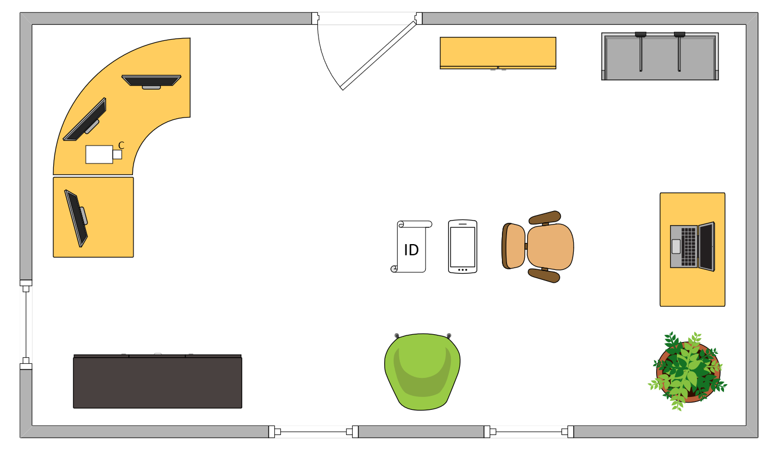

Tim’s Ideal Testing Room
No interruptions or bio breaks
Cover monitors and cameras
Pull back for environment photos
Clear table with laptop

Slide 78
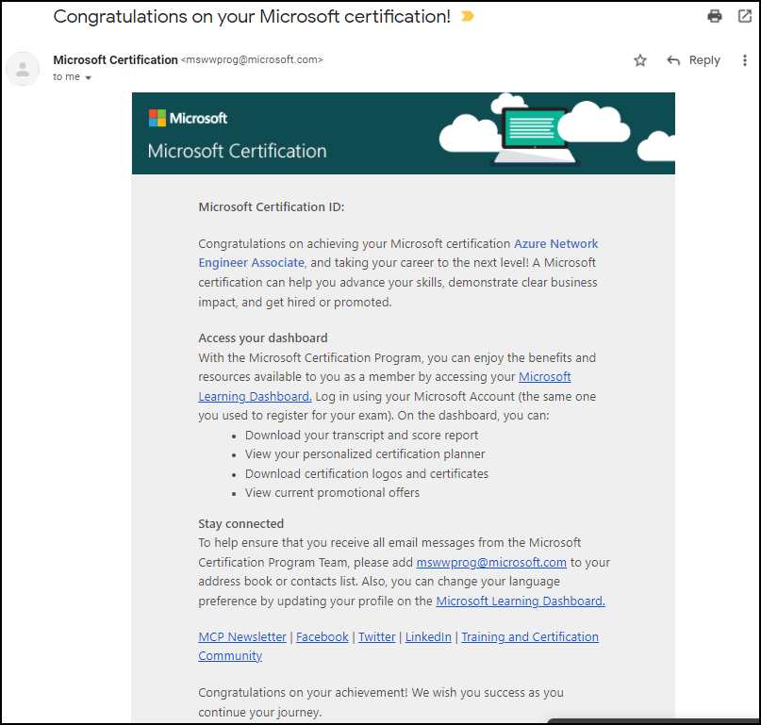
Congratulations!

Slide 79
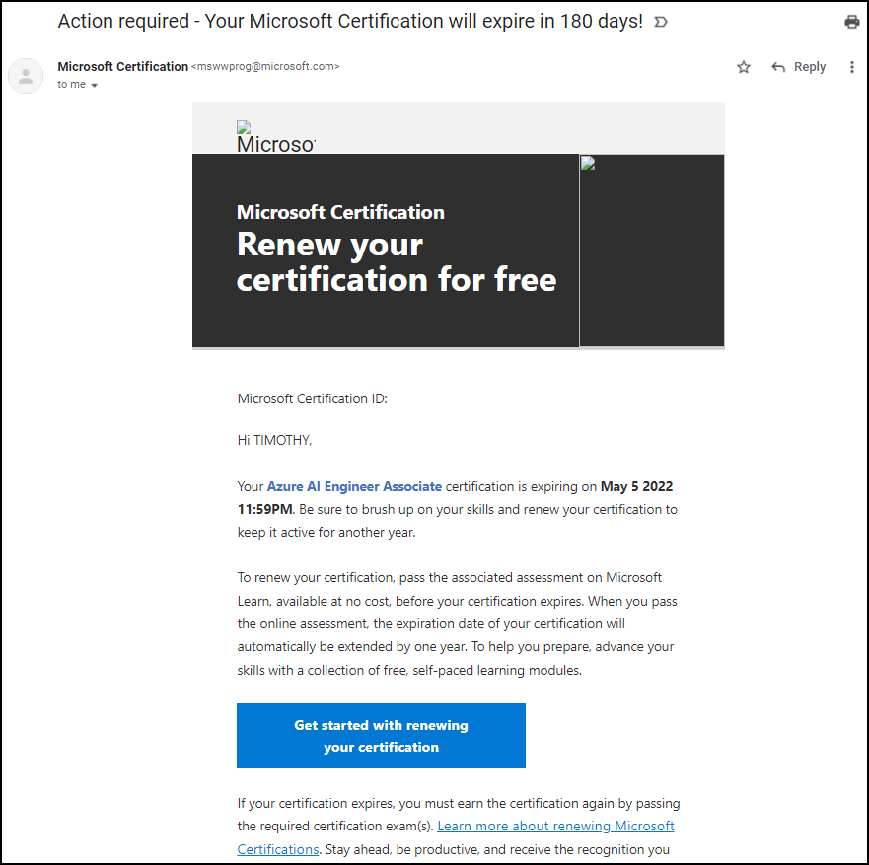
Certification Renewal

